Slide 1

Workplace assistant augmented reality
Gabriel Camilleri

Slide 2
Problem Definition

Slide 3

Problem Definition
To build a real-time assisting application which can help interns and visitors easily adjust within a workplace
An application which would addresses job fitness for new employees
To provide an assistant augmented reality application
Applying object and image recognition in combination with the right user profiling and recommendation techniques.

Slide 4
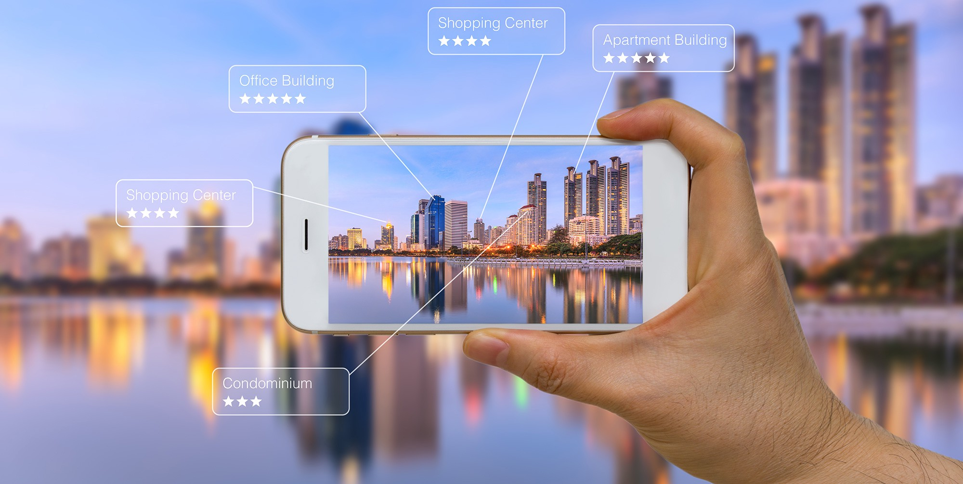
Research Questions
Which is the right Augmented Reality Library for the current context?
What are the right computer vision techniques to apply?
What models and techniques are suitable to implement user profiling and recommendation depending on the user’s task at hand?

Slide 5
Background and literature review

Slide 6
Background Research and Literature Review
Workplace AR training normally is provided in two forms:
On the job training
Off the Job training
AR can provide training by overlaying 2D and 3D information in real-time, whilst also providing the users the ability to author the environment around and interact with it.
Vuforia is compatible with more smartphones than ARCore and ARKit, thus having the ability to run not just on the latest smartphones.
Vuforia provides traditional computer vision techniques and deep learning techniques for image and object recognition
Vuforia makes use of pose feature detection, taking into consideration position and orientation of the natural features as well as extended tracking.

Slide 7
Background Research and Literature Review (Cont.)
As discussed within their research by T.Haritos and N. D. Macchiarella “A mobile application of augmented reality for aerospace maintenance training” [1], OJT is commonly used for maintenance training
The drawback is that the process is unmethodical and comments may be infrequent.
So why not combine OJT with off the job via AR?
Recommendation systems are a valuable tool for AR applications, they can provide relevant augmented information according to the user’s preferences and cope with information overload, as discussed in the research carried out by C. P. de Miguel [2].
Collaborative filtering algorithms are commonly used for recommendations [3].
When applied to the MovieLens dataset SVD++ performed best in comparison to other models [3].
The problem when applying these models in AR is, they fully depend on:
Location, timing, first use of the app and immediate responses from the application.
Distance based, time based, and visibility based recommendation are common in AR applications as discussed in [4].

Slide 8
Background Research and Literature Review (Cont.)
Augmented Reality makes use of image and object recognition technology
Such technology depends on traditional computer vision techniques and deep learning techniques
Traditional techniques are useful when recognising 2D images and characters due to using edges and contours as natural features to identify
Deep Learning technology is applicable in scenarios where that object may differentiate in its state due to the lighting variances, distance variances, rotation variances, and occlusion variances as the technology is trained on that specific 3D object using different frames capturing different angles, distances and colours in which that object may appear in, thus being capable of generalising [5].
Occlusion is a main problem in AR
A research conducted by [6], used a combination of Surf Technology and combined it with Golay error correction code detection
An object could be placed 2m away from the camera
Handled under 55 degrees angle to the camera’s axis
Not affected by up to 55% obstruction
Another approach presented by [7] used deep learning on multiple frames of the same object.

Slide 9
Design and Implementation

Slide 10
The 3 Main Components of the System
The user
Augmented Reality
User Recommendation System

Slide 11
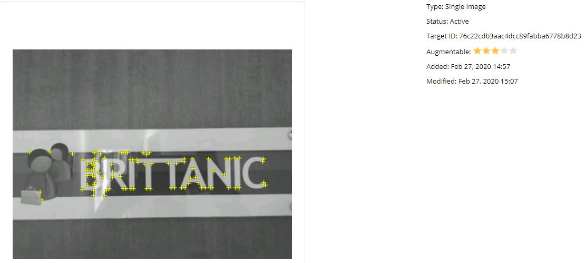
Data Handling
AR component
Images were taken
Initially of corridors
Feature extraction problem
Specific door signs were chosen as markers
Had unique distinct features
3D models were generated (11 in total)
Recommendation Component
A prototype dataset was built from scratch containing user-ratings
3 datasets in total for 3 separate tasks for the Visitors
Visit
Delivery
Interview

Slide 12
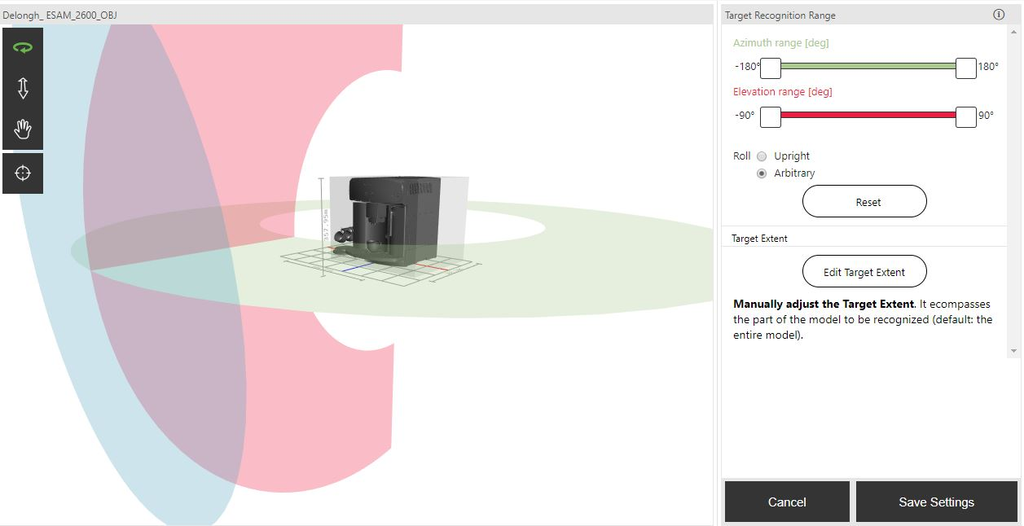
Feature Extraction
Images were fed into Vuforia’s library and were processed using traditional CV techniques.
Detecting edges and contours
3D objects were fed to Vuforia’s model generator to perform deep learning techniques on.
Detecting edges and contours at different lightings, distances, and angles.
Dataset built using different frames of the same object

Slide 13
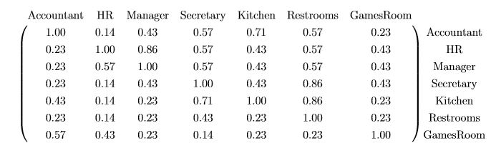
Feature Extraction (Cont)
User Recommendations
Collaborative Filtering
Features, were user ids, task ids and ratings.
Fed to SVD++ model
Matrix Factorisation method
Item-item similarity based matrix
Based on term frequency
Visibility based
Normalised
Based on the amount of times an office (term) is passed by the user while finding an office in particular (document)
Did not apply tf-idf
matrix scaling was done using one-fold normalisation since a term (a location within the office) appears in every task (a task is equivalent to a document)

Slide 14
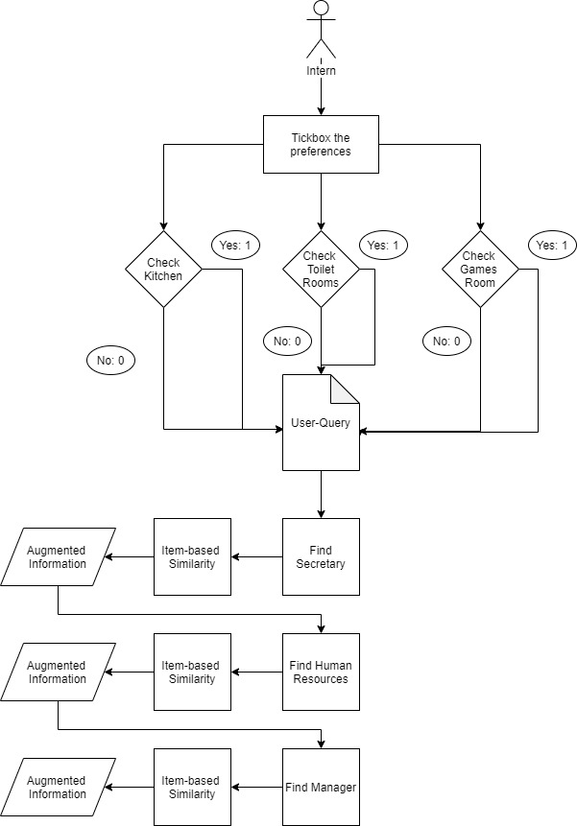
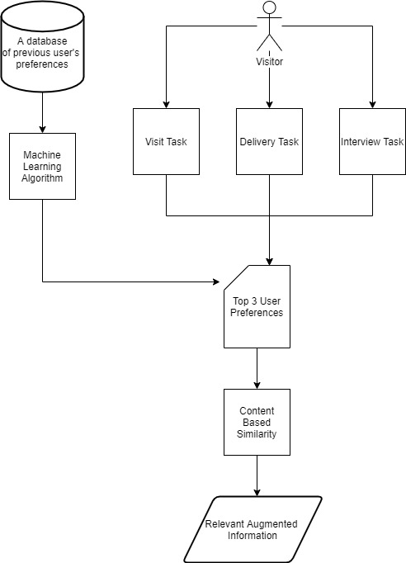
User-Query Models
Intern-Query Model
Visitor-Query Model

Slide 15
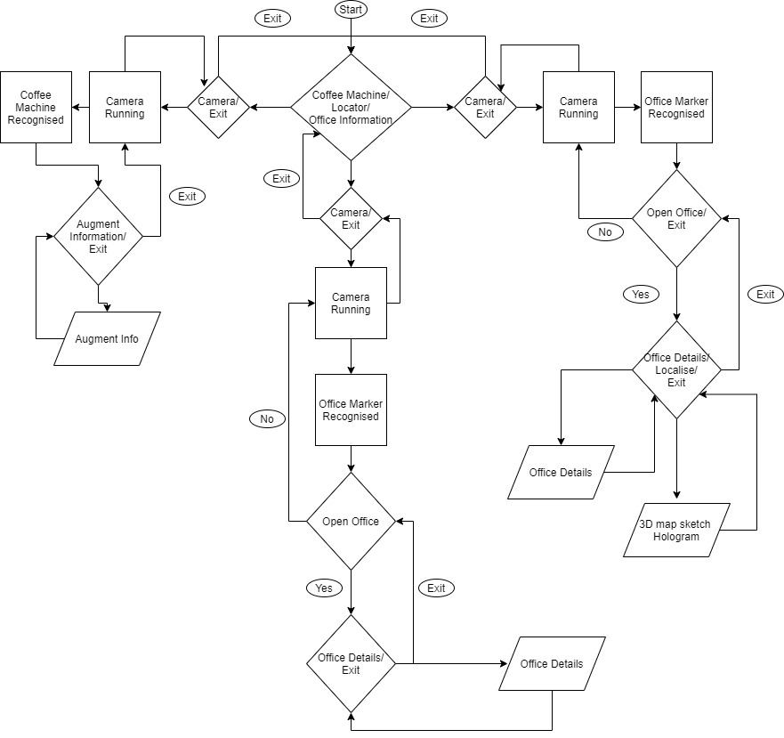
Architecture
Offices Information
(wandering around)
Locator
Intern
Step By step process
Secretary
HR
Manager
Visitor
Profiling on:
Visit
Interview
Delivery
Coffee Machine

Slide 16
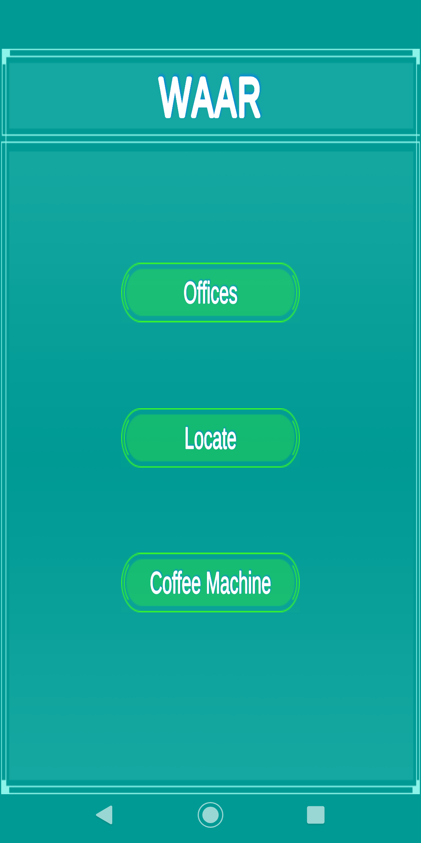
Main Menu

Slide 17
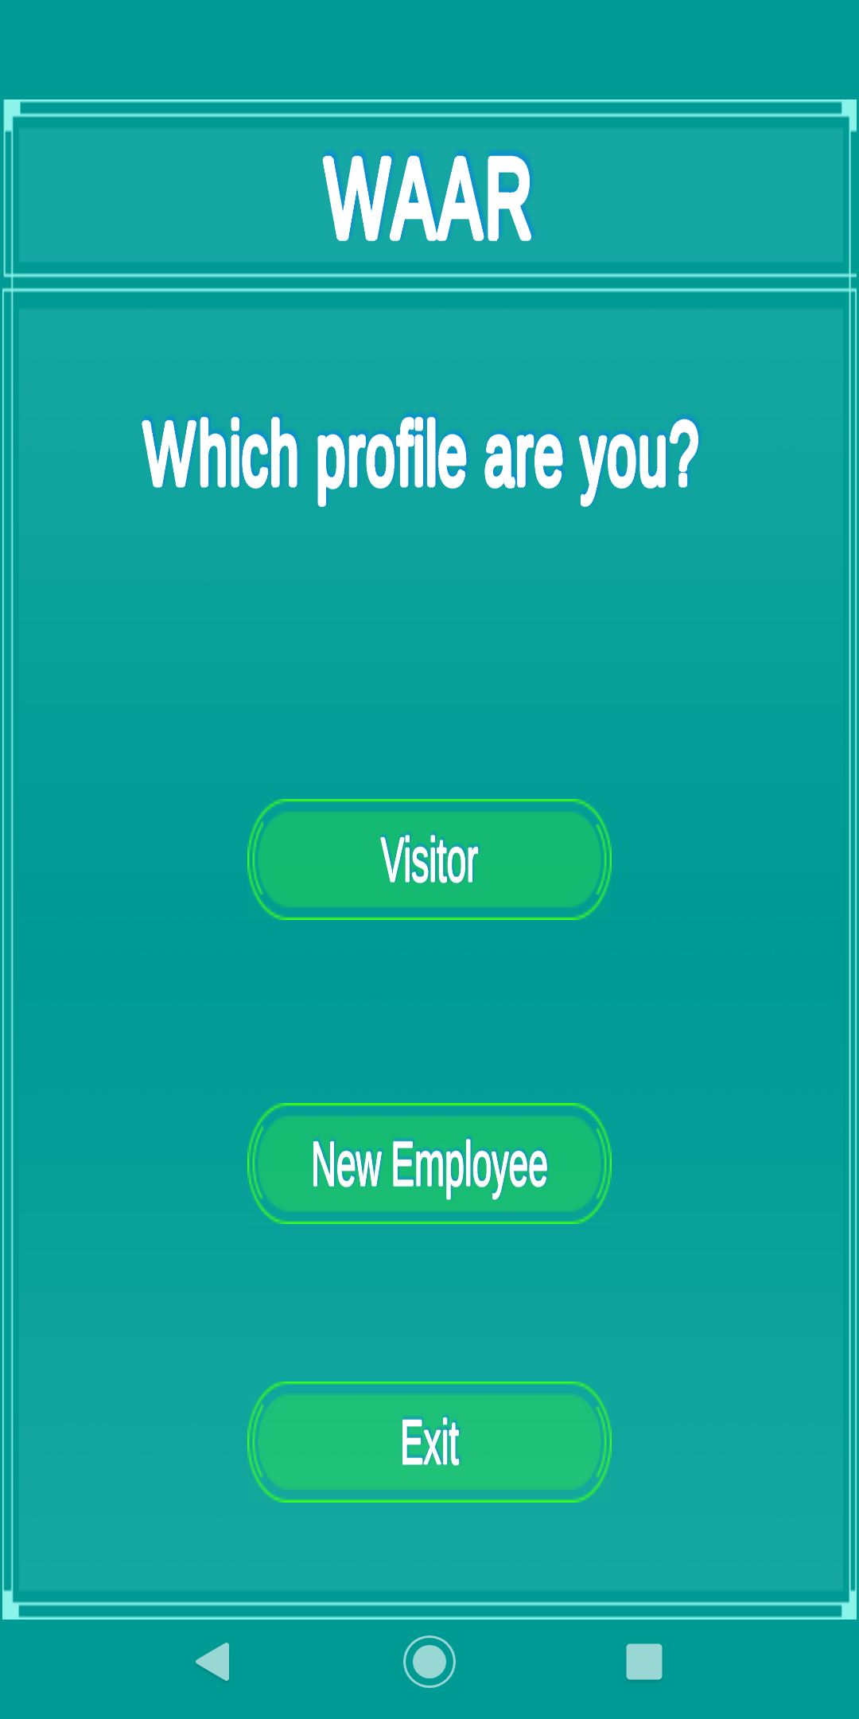
Choosing a user profile

Slide 18
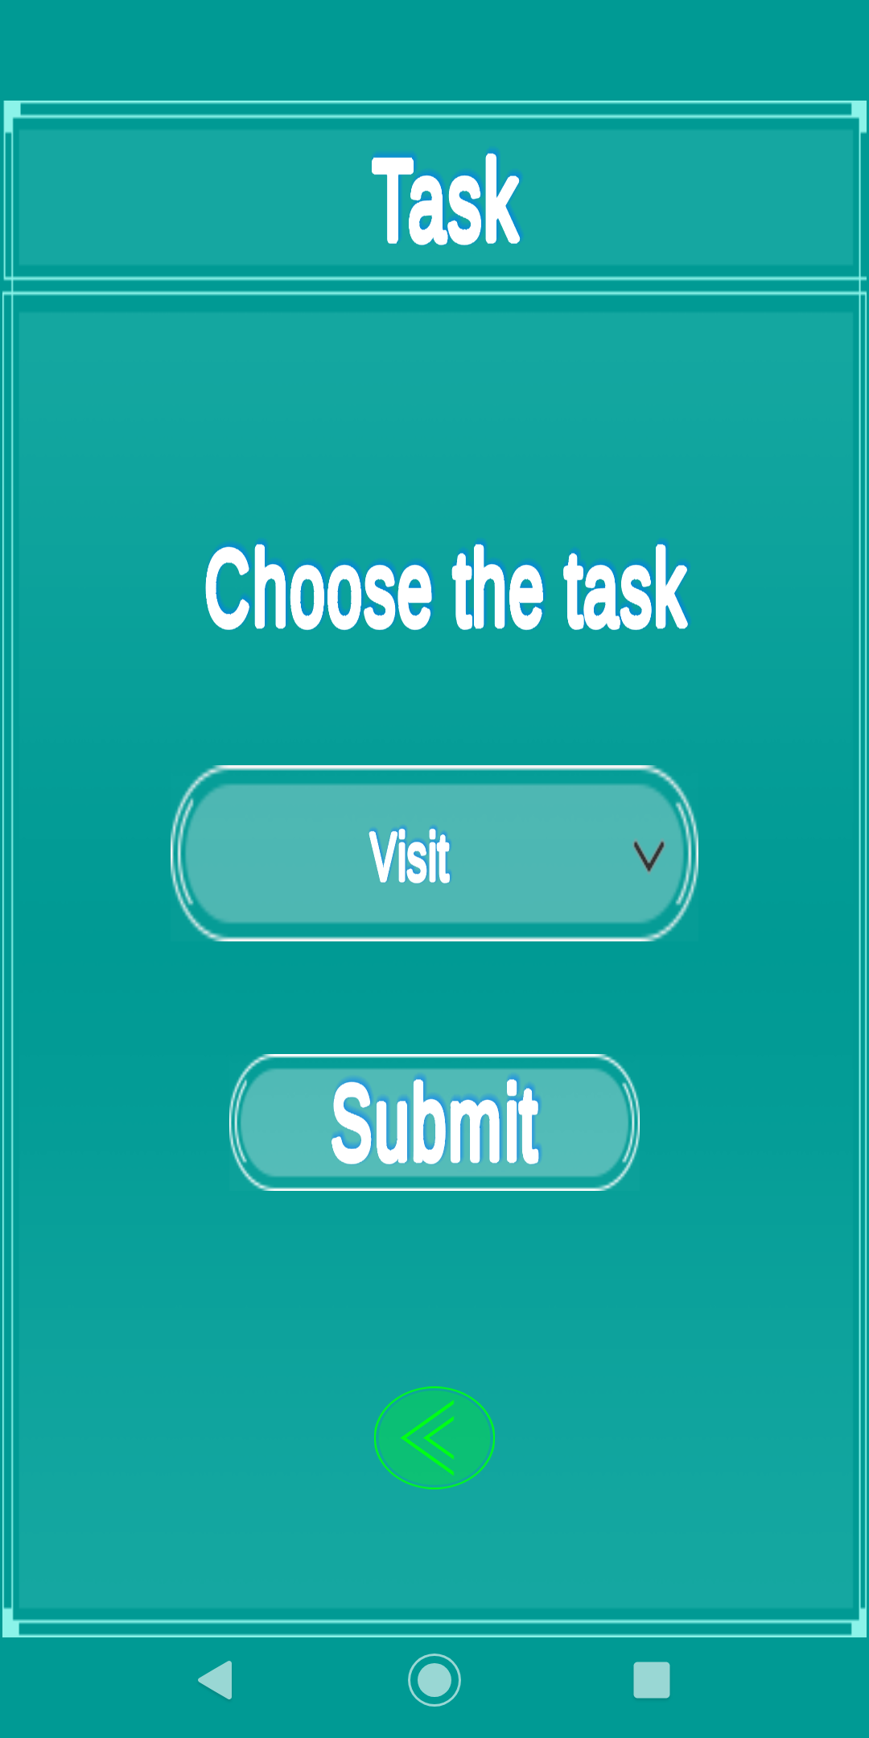
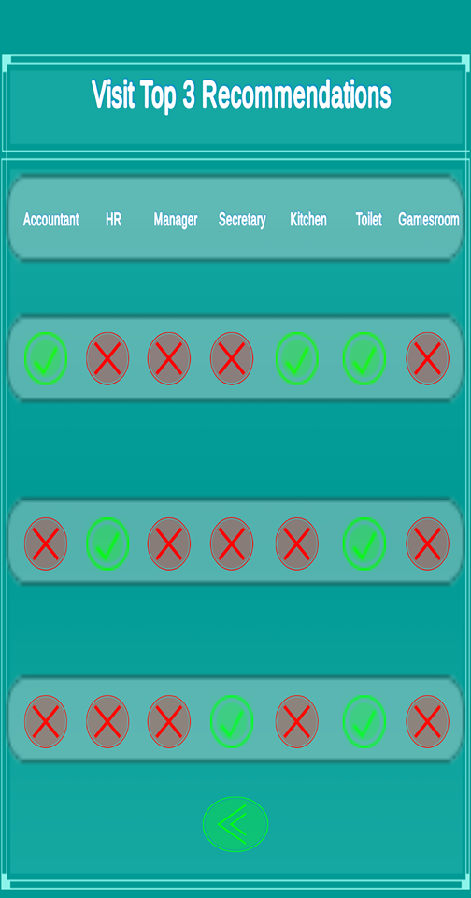
Visitor’s Section

Slide 19
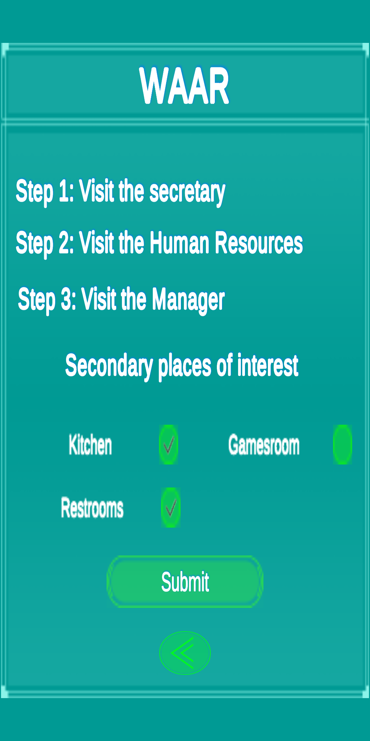
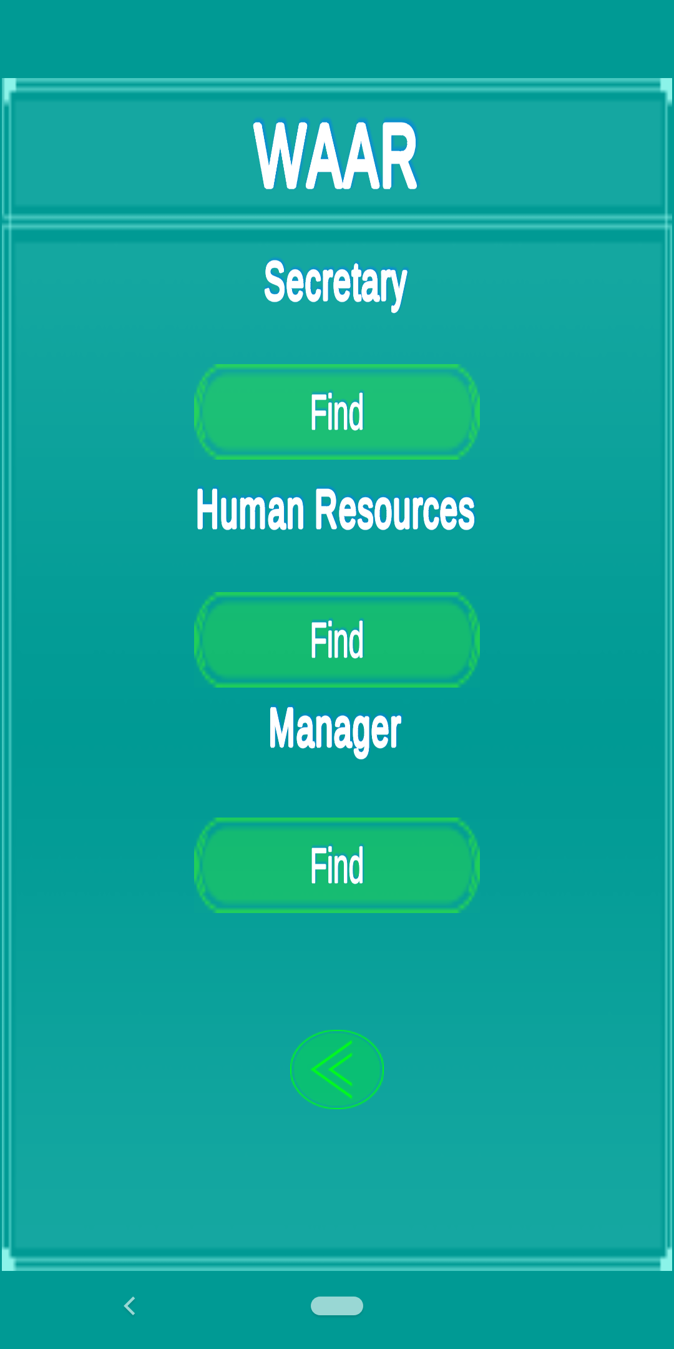
Intern’s Section

Slide 20
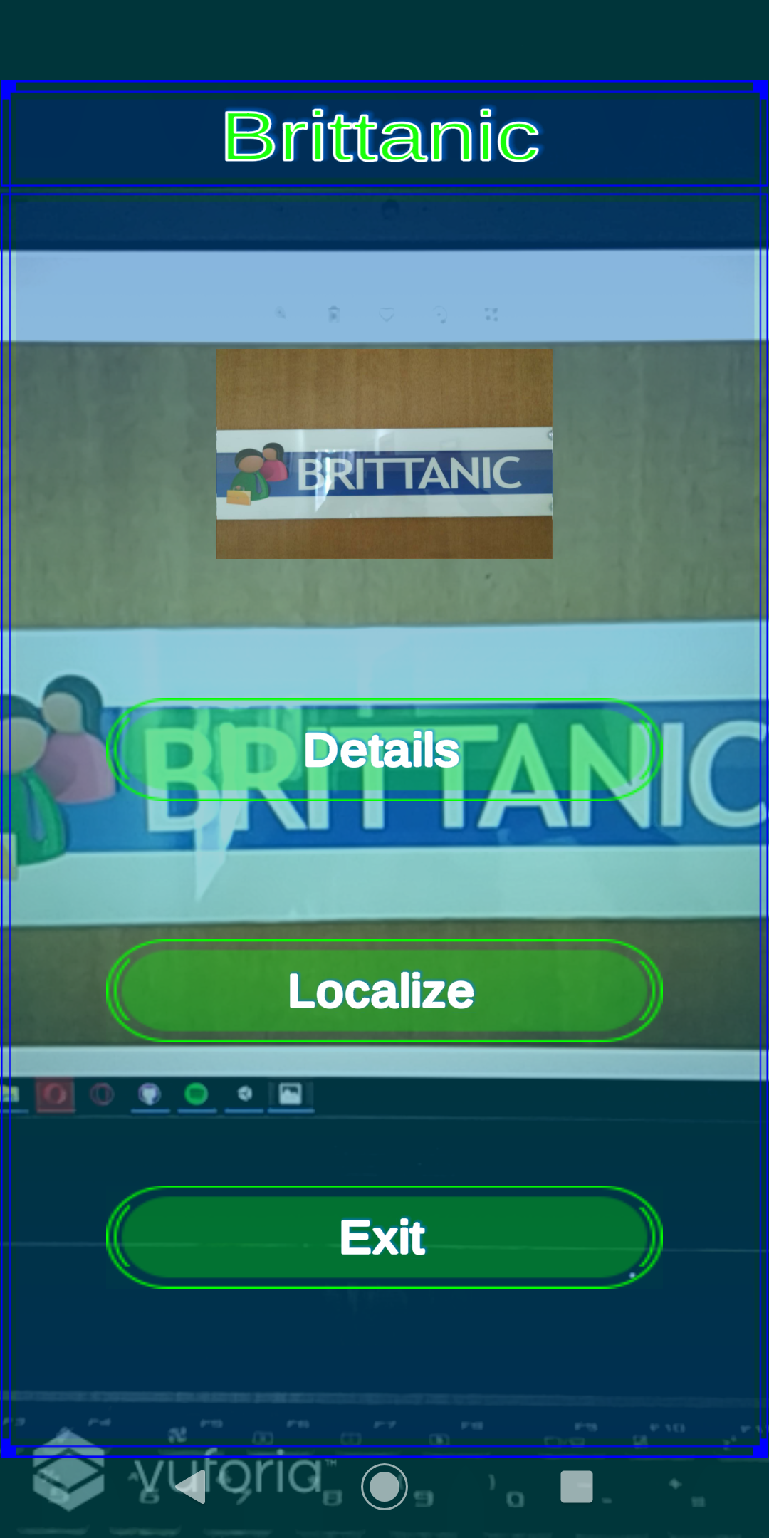
Augmented Reality Offices

Slide 21
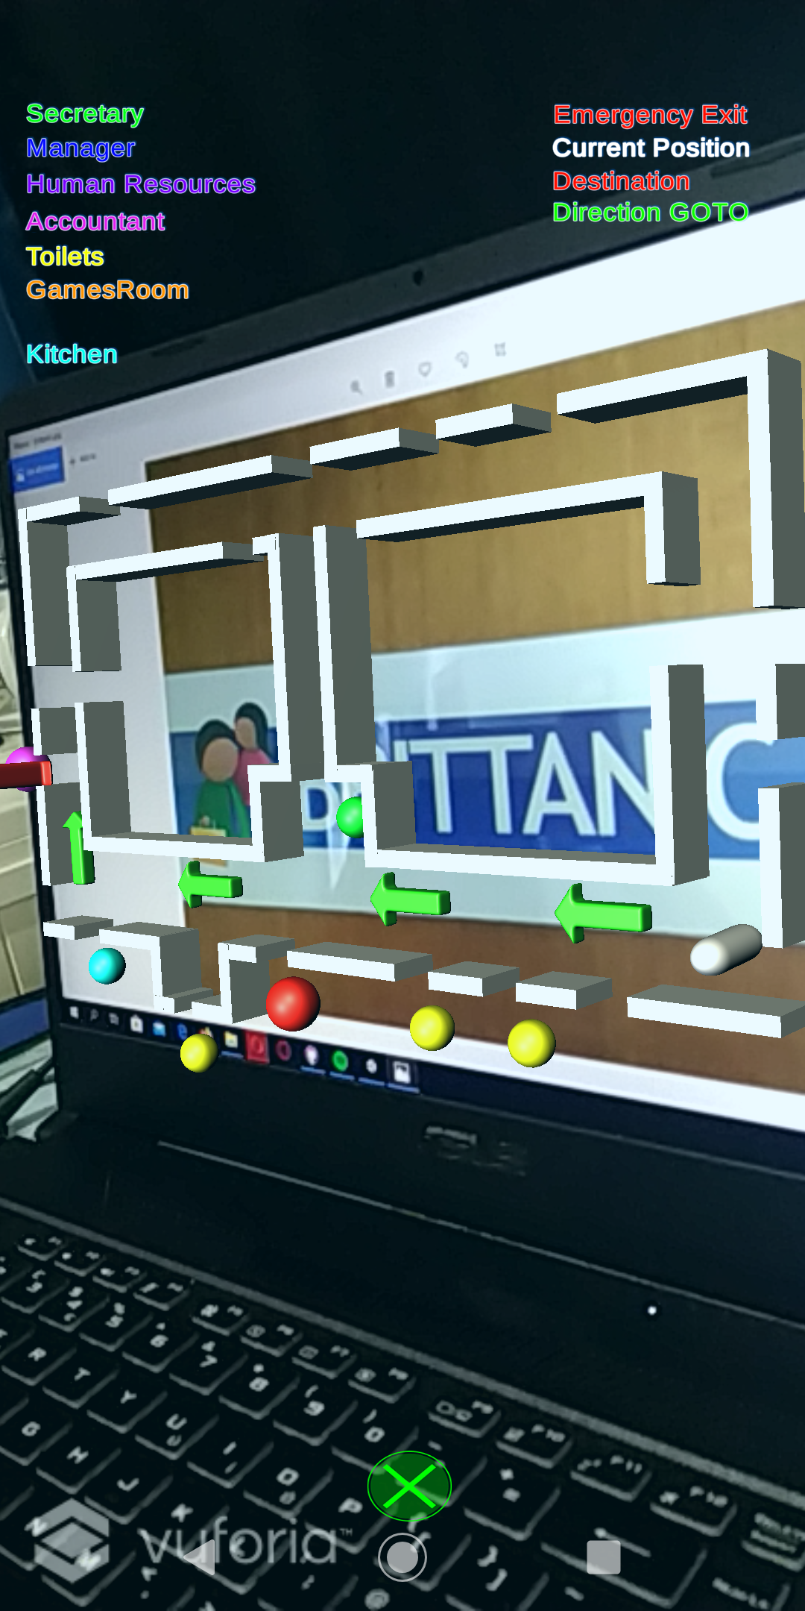
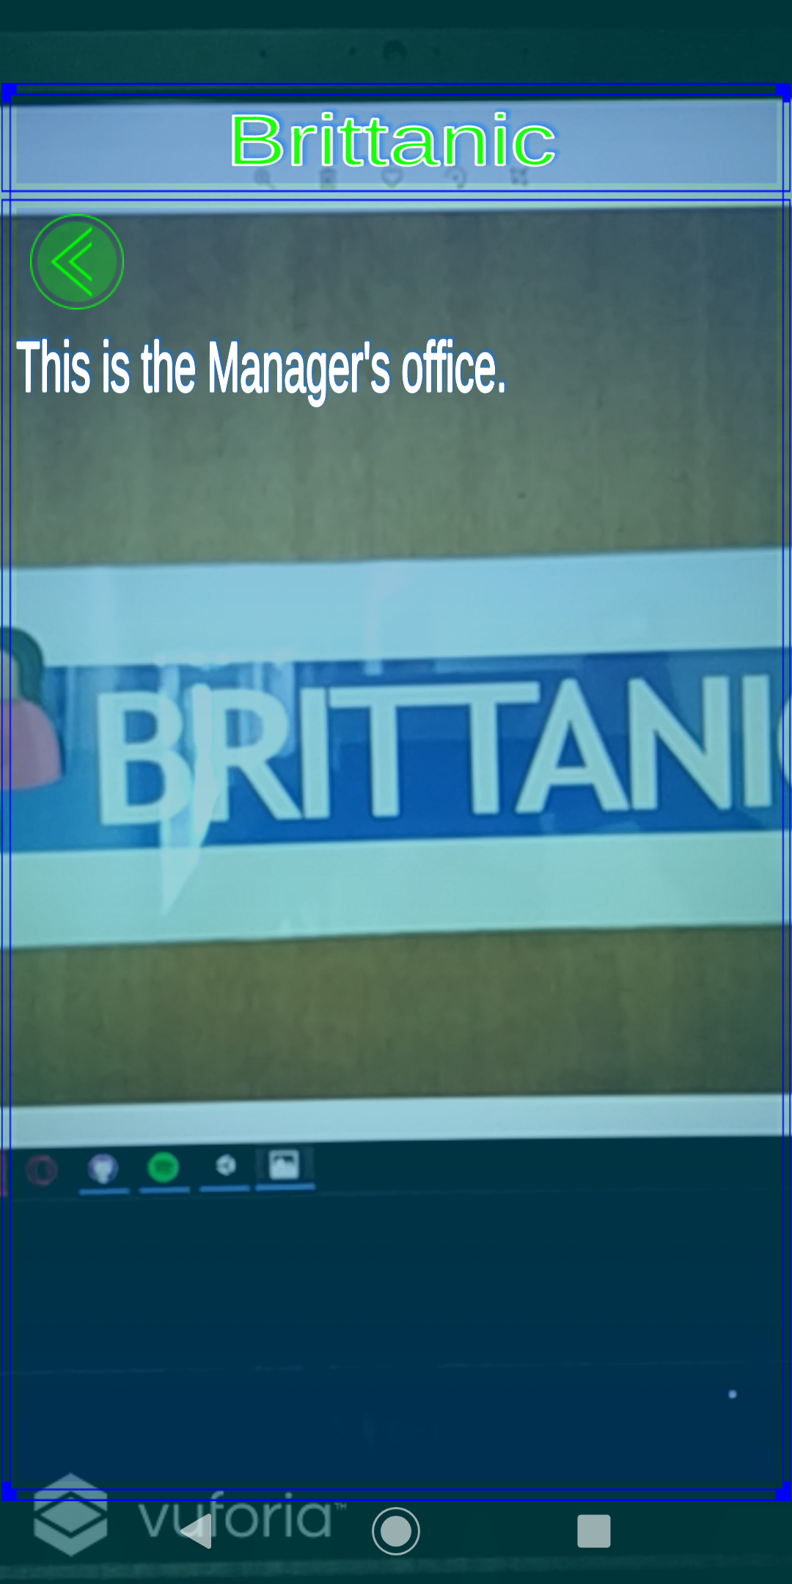
Augmented Reality Offices

Slide 22
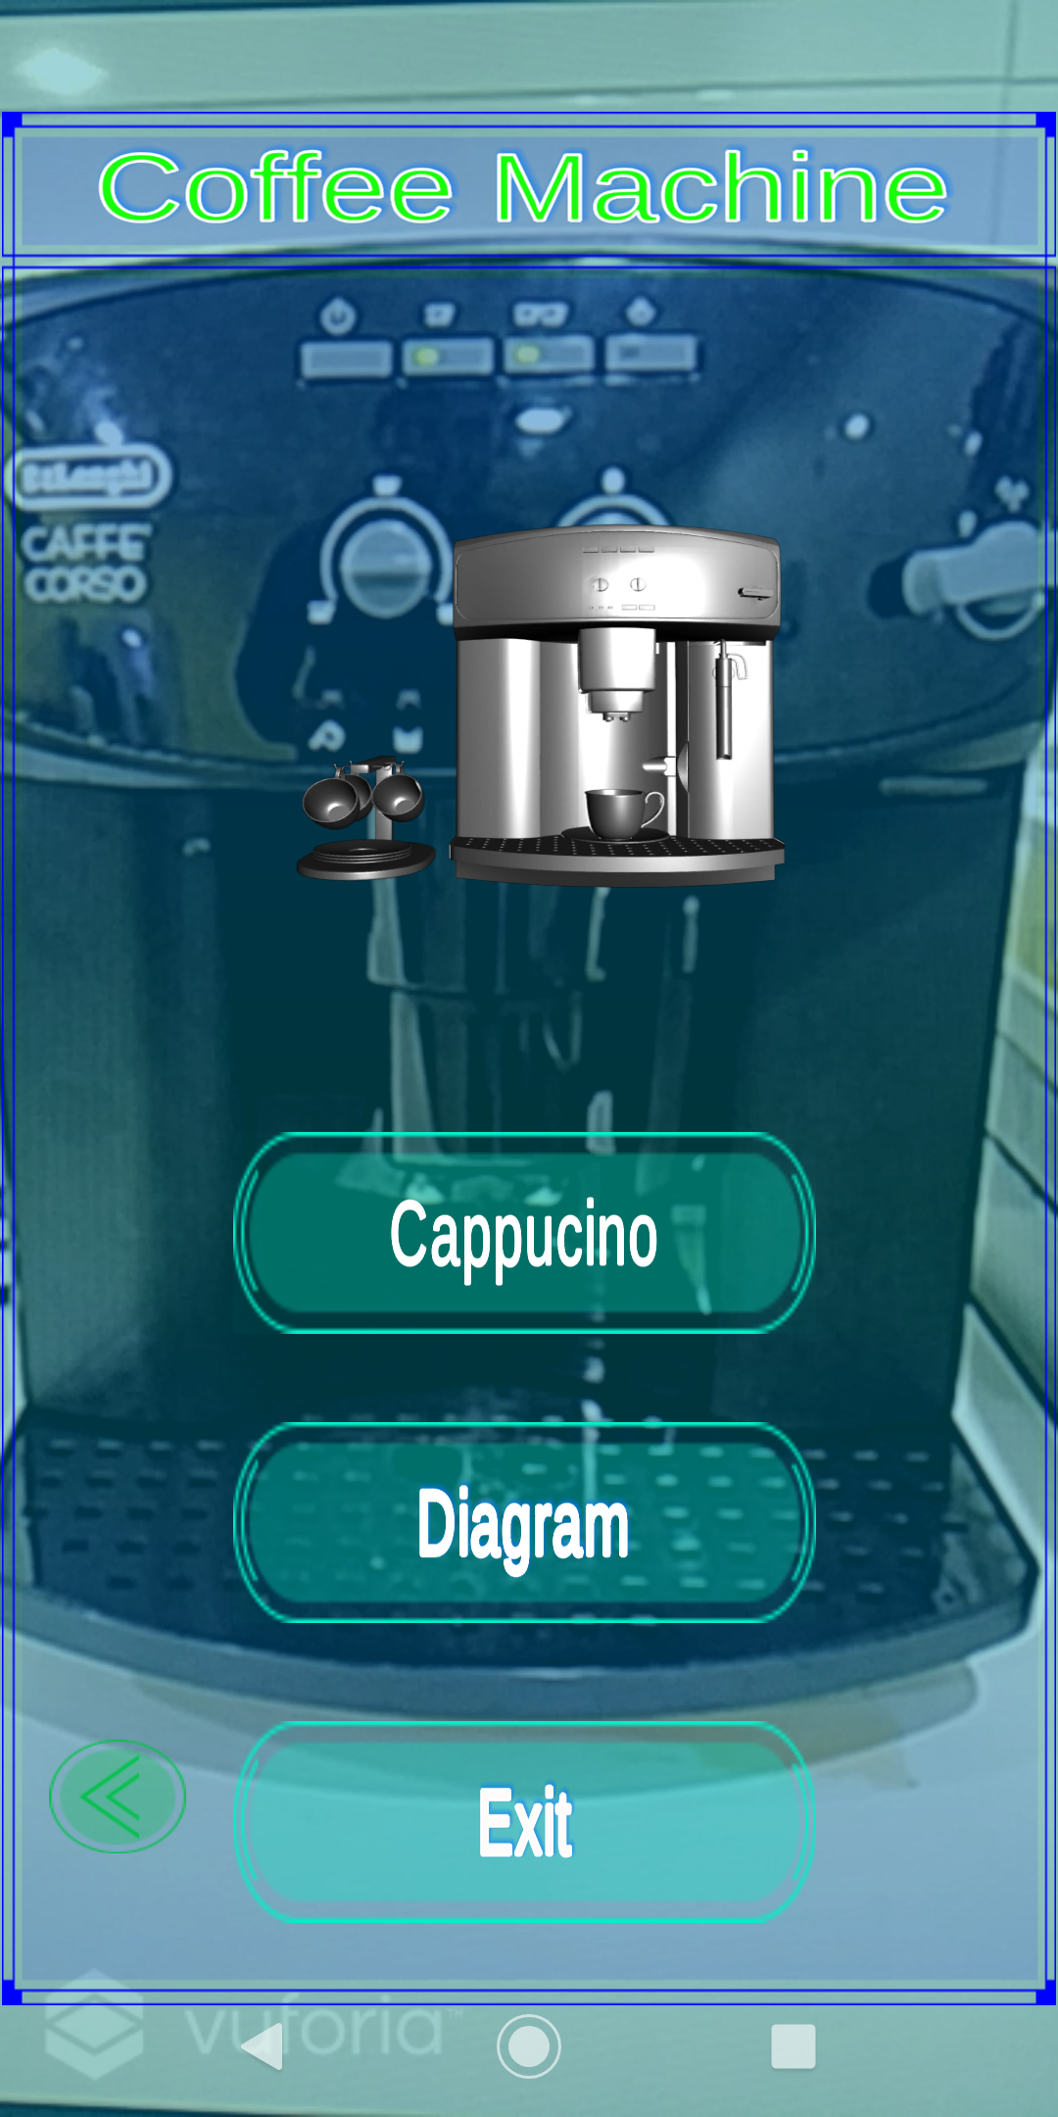
Coffee Machine

Slide 23
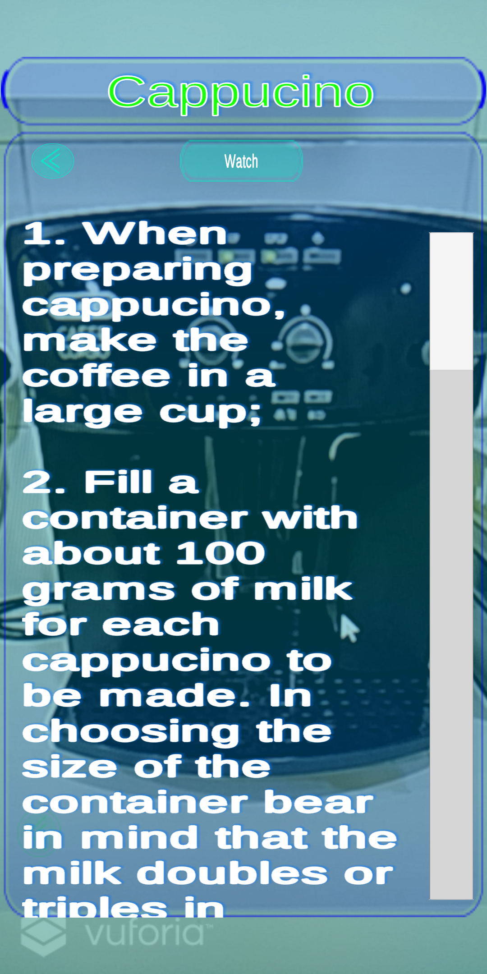
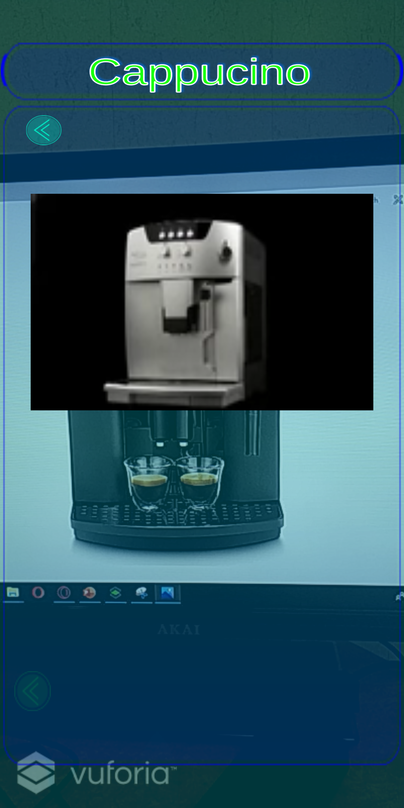
AR Coffee Machine Cappuccino Details

Slide 24
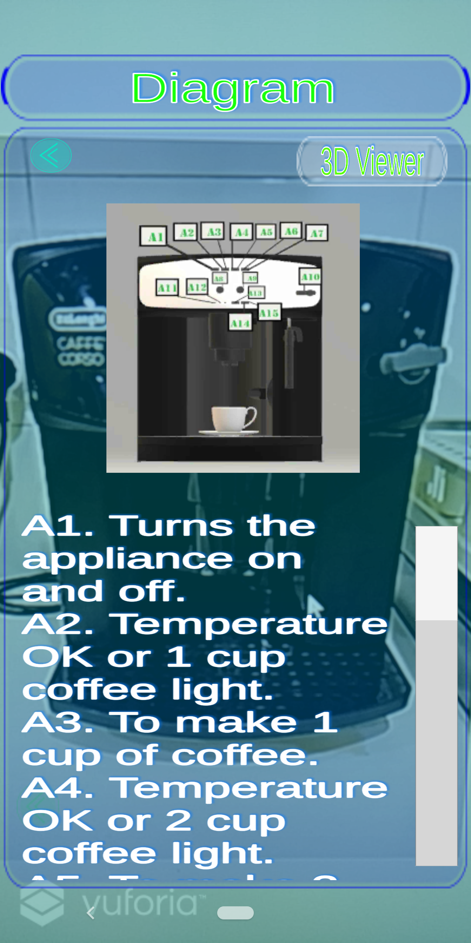
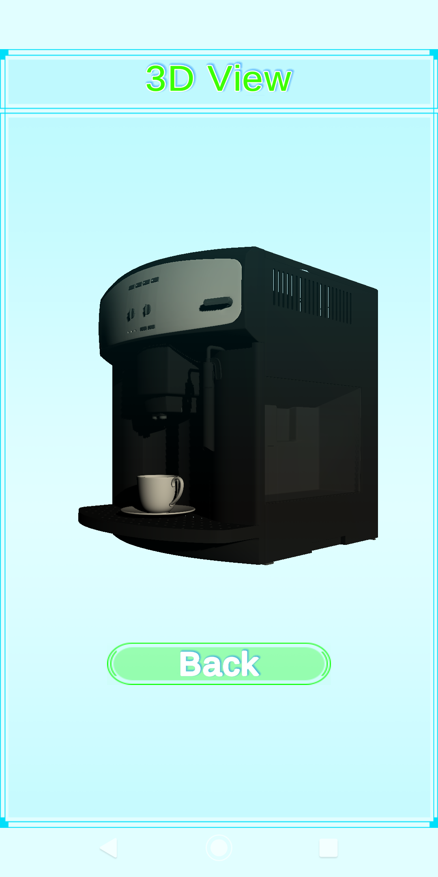
AR Coffee Machine Cappuccino Details

Slide 25
Testing And Evaluation

Slide 26
Quantitative AR Testing
Testing cannot be done on the algorithms’ performances of the library as developers do not have complete access to the API.
Common methods of the AR app’s tests are on the following component:
Colour Variance
Distance Variance
Orientation Variance
Occlusion Variance
Each test repeated a total of 21 times
10 – Image Targets
11 – Model Targets

Slide 27
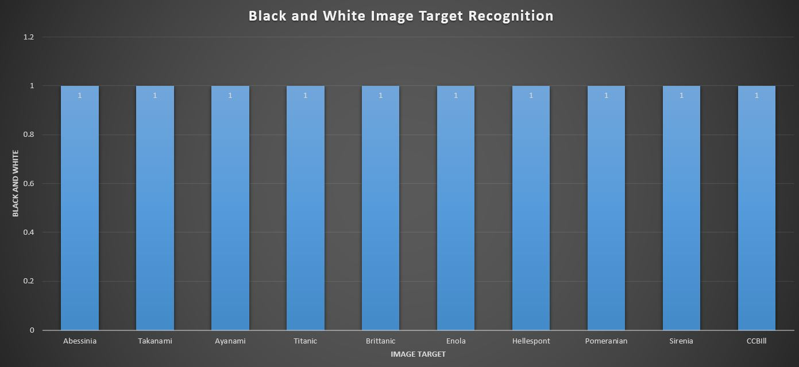
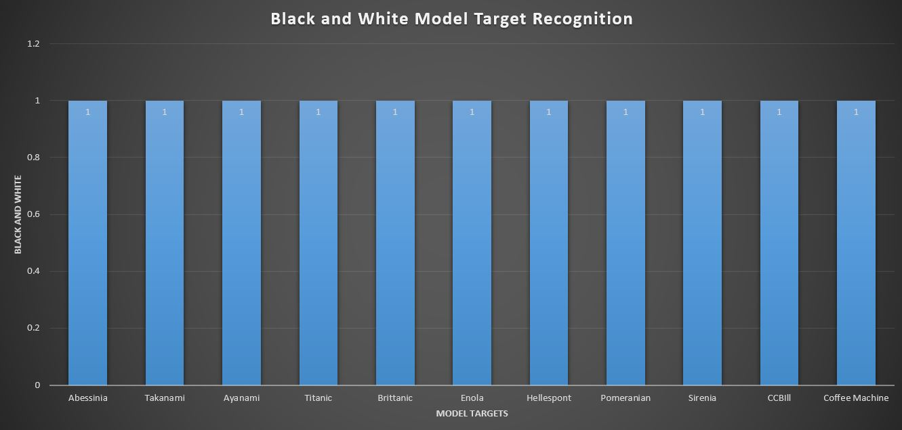
Colour Variance
Image Targets
Model Targets

Slide 28
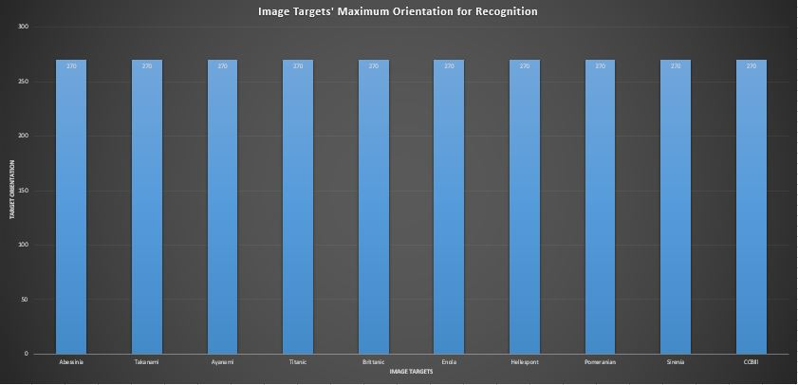
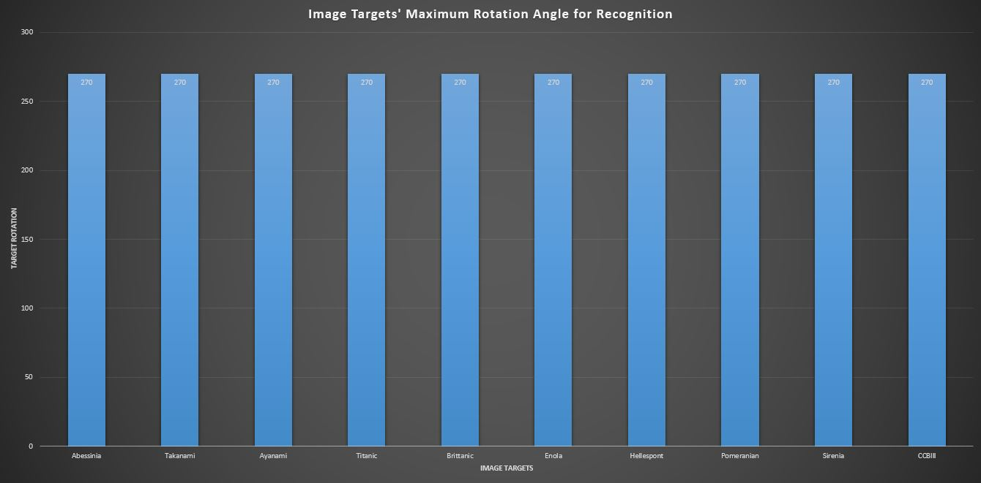
Orientation Variance
Image Targets
Model Targets

Slide 29
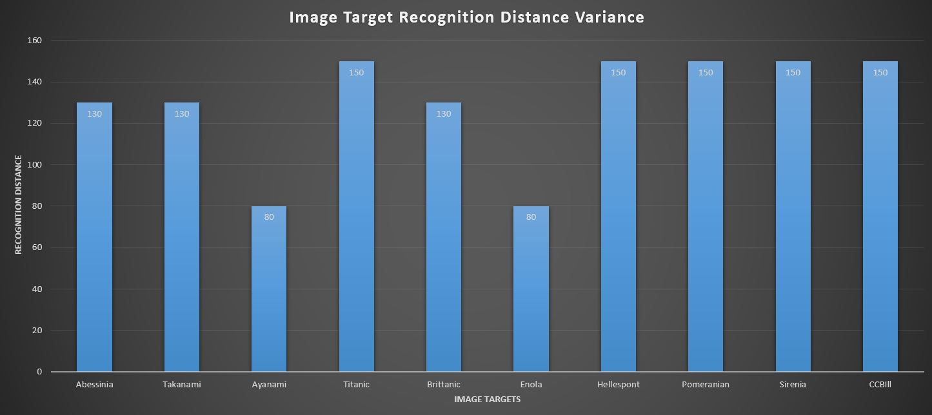
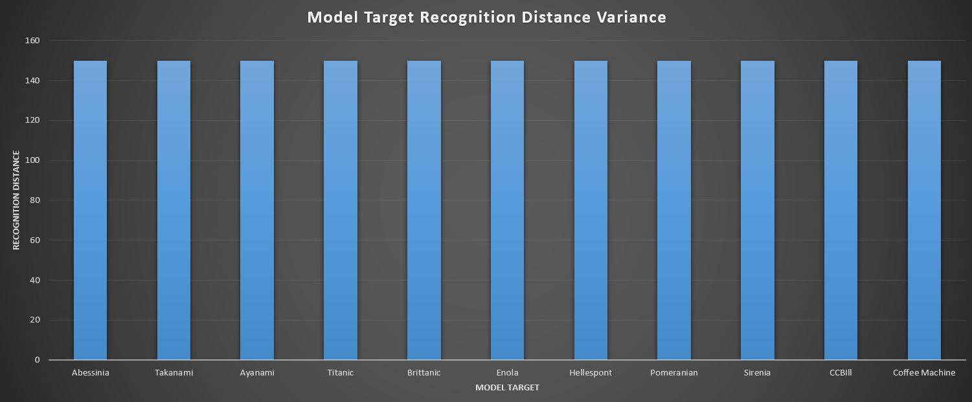
Distance Variance
Image Targets
Model Targets

Slide 30
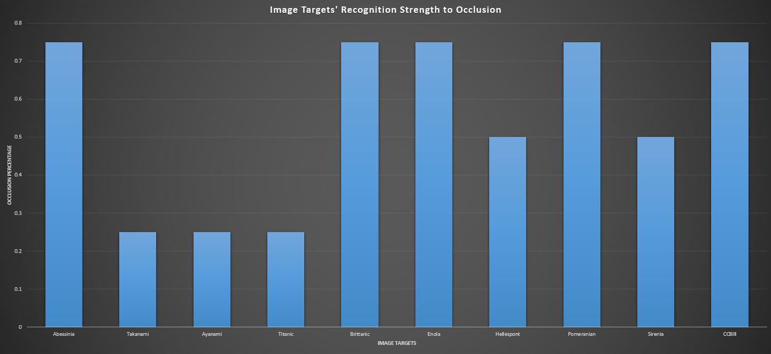
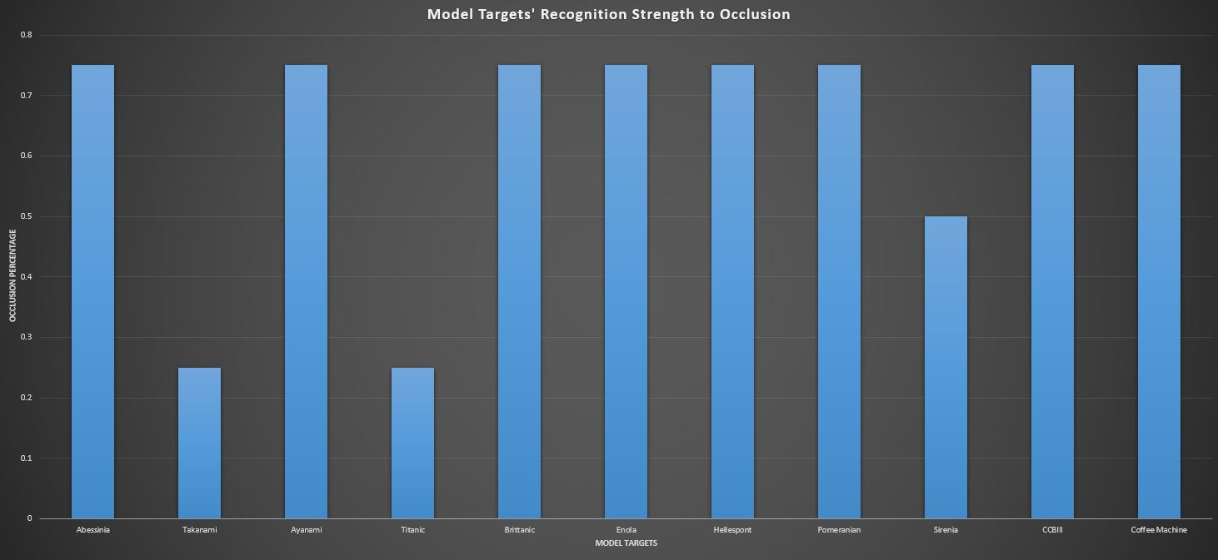
Occlusion Variance
Image Targets
Model Targets

Slide 31
Quantitative RS Testing
Baseline Comparison with
SlopeOne, BaselineOnly, Normal Predictor, KnnZscore, KnnBasic, KnnBaseline, SVD, CoClustering
Comparison on MAE and RMSE value
Recent Papers use MAE for comparison
Older papers use RMSE for comparison
Testing was done separately for each task (Visit, Interview, and Delivery)
Overall task Mean calculated
Secondary values calculated:
Test and Fit time
HyperParameter tuning was performed

Slide 32
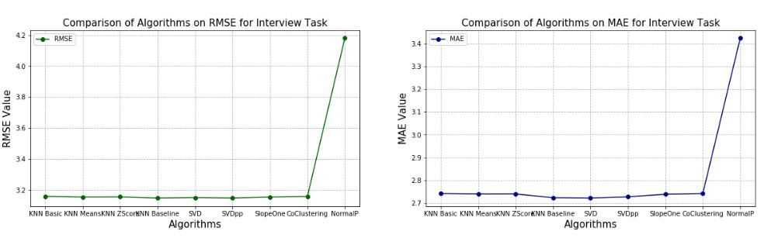
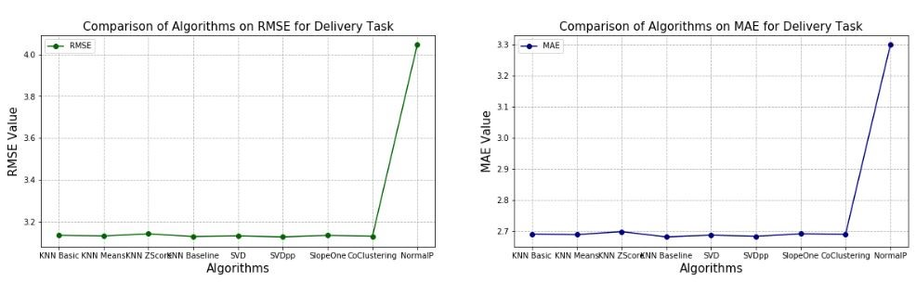
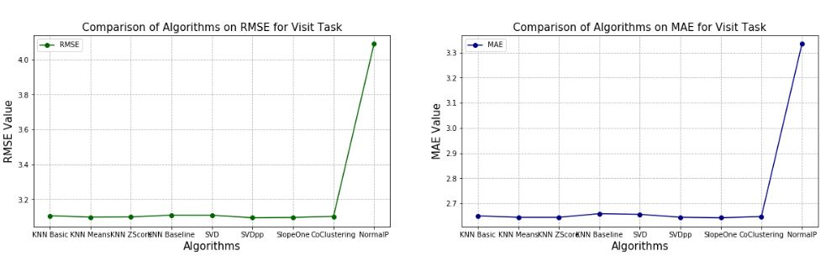
Baseline Comparison of Algorithms
Interview
Delivery
Visit

Slide 33
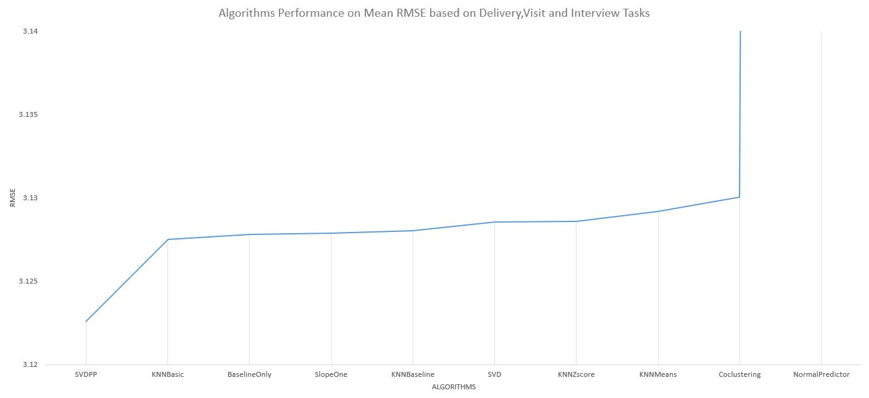
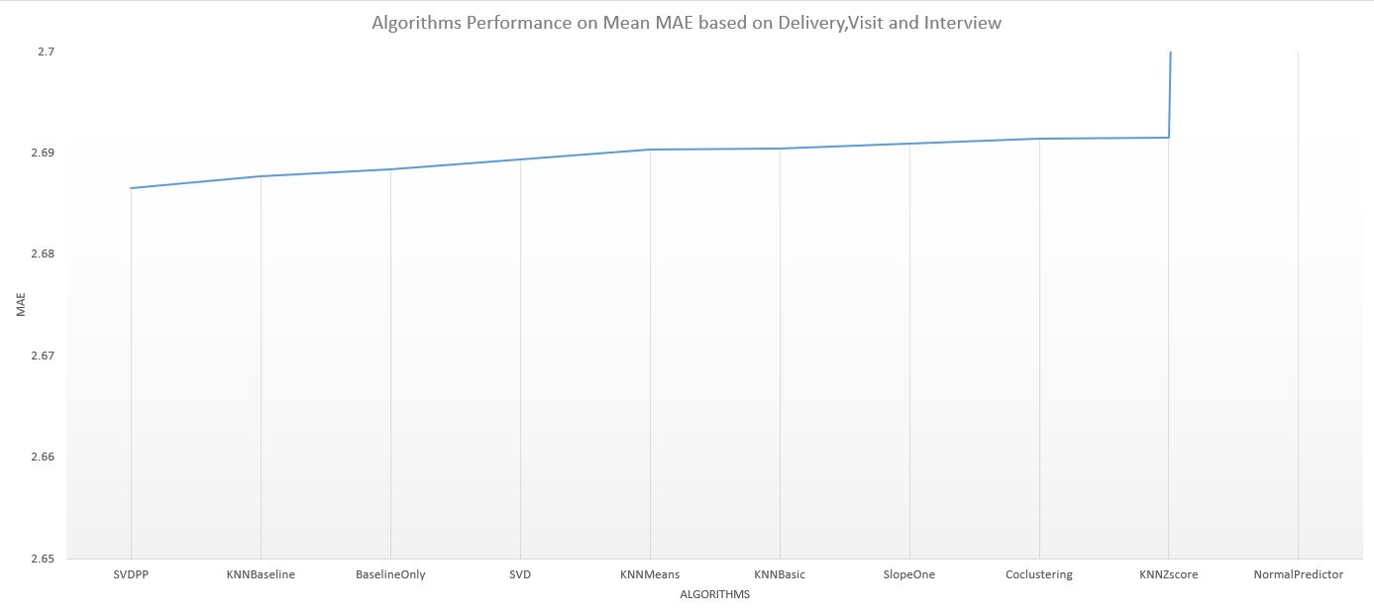
Baseline Comparison of Algorithms
Mean RMSE
Mean MAE

Slide 34
Quantitative Testing
In total 30 participants participated
15 CCBill employees
15 Non-CCBill employees
All of the participants found the application assisting for completing a given task such as locating an office
On average participants found augmented information as helpful (4.23)
On average participants found recommendation system as helpful (4.27)

Slide 35
Quantitative Testing (Cont.)
On average most participants agreed that the application was not affected by lighting and occlusion (1.63)
Interaction felt like natural and realistic (1.07)
Most users complained on the following issues
3D map was confusing
Unfortunately mostly to CCBill participants
Panning up and down
A greater amount found the application easy to use especially non-CCBill participants
CCBill participants found the recommendation system confusing as to how it functioned.

Slide 36
Challenges and Limitations
Choosing the right markers
Static markers
Dynamic markers
Must use deep learning techniques trained on all the variations of the marker.
Choosing the right user profiling to apply depending on the context in which they are used in
No pre-existing database
Vuforia cannot handle multiple model targets in one Unity scene
Used image targets
When activated the respective model target is then activated
Caused the panning issue where a slight delay occurs due to the application’s inability to quickly switch from image target to model target recognition

Slide 37
Future Work
Encourage the company gradually improve the recommendation algorithms they apply for profiling.
Random walk (if without a dataset), then apply an svd++, and finally make use of deep learning.
Real World interaction via augmented reality
Interact with real world devices such as lighting, printers, coffee machines and punch clocks.
Allow the users to also book an office on the spot when viewing information about it, making use of the company’s shared online calendar.
Include holographic live directions via location based AR
Would need to switch to ARKit or ARCore if the company prefers to invest in an indoor positioning system
Can use Vuforia by feeding the model targets 3D detailed models of the corridors.

Slide 38
Future Work (Cont.)
Include explainable AI
Interpret the models applied and their results
Improves transparency with human-interpretable explanations

Slide 39
To Conclude…
Vuforia traditional CV techniques and deep learning techniques were used in combination to provide the augmented reality side of the application.
Collaborative via SVD++ and item to item based similarity filtering techniques were used to provide the user profiling and recommendation component of the application.
11 markers were used in total including the coffee machine
Quantitative testing for performed on the AR and User profiling components
Distance, colour, rotation and occlusion variances were tested on the AR component
SVD++ on average performed best in comparison to other models in baseline testing.
Qualitative testing was performed on the overall application
On average the system achieved positive and promising results highlighting the applicability of the techniques applied and implemented for the context in which they were used in.
The results seem to be successful. However, one should not ignore or overlook the fact that there will always be room for improvement and innovation.

Slide 40
Acknowledgements
The faculty for allowing me to perform such research
Dr.Camilleri for her constant support and feedback.
CCBill for allowing me to carry out the research within their workplace.

Slide 41
References
T. Haritos and N. D. Macchiarella, “A mobile application of augmented reality for aerospace maintenance training,” in 24th Digital Avionics Systems Conference, vol. 1, Oct 2005, pp. 5.B.3–5.1.
C. P. de Miguel, “Arlodge : Context-aware recommender system based on augmented reality to assist on the accommodation search process,” 2014.
F. Cacheda, V. Carneiro, D. Ferna´ndez, and V. Formoso, “Comparison of collaborative ﬁltering algorithms: Limitations of current techniques and proposals for scalable, highperformance recommender systems,” TWEB, vol. 5, p. 2, 01 2011.
Z. Zhang, S. Shang, S. R. Kulkarni, and P. Hui, “Improving augmented reality using recommender systems,” in Proceedings of the 7th ACM Conference on Recommender Systems, ser. RecSys ’13. New York, NY, USA: Association for Computing Machinery, 2013, p. 173–176. [Online]. Available: https://doi.org/10.1145/2507157.2507211
V. Lepetit, “On computer vision for augmented reality,” 08 2008, pp. 13 – 16.
D. Procha´zka, O. Popelka, T. Koubek, J. Landa, and J. Kolomaznik, “Hybrid surfgolay marker detection method for augmented reality applications,” Journal of WSCG, vol. 20, pp. 197–204, 01 2012.
M. Garon and J.-F. Lalonde, “Deep 6-DOF tracking,” IEEE Transactions on Visualization and Computer Graphics, vol. 23, no. 11, 2017.

